Slide 1
Chapter 2
2-4 ~ 2-5

Slide 2
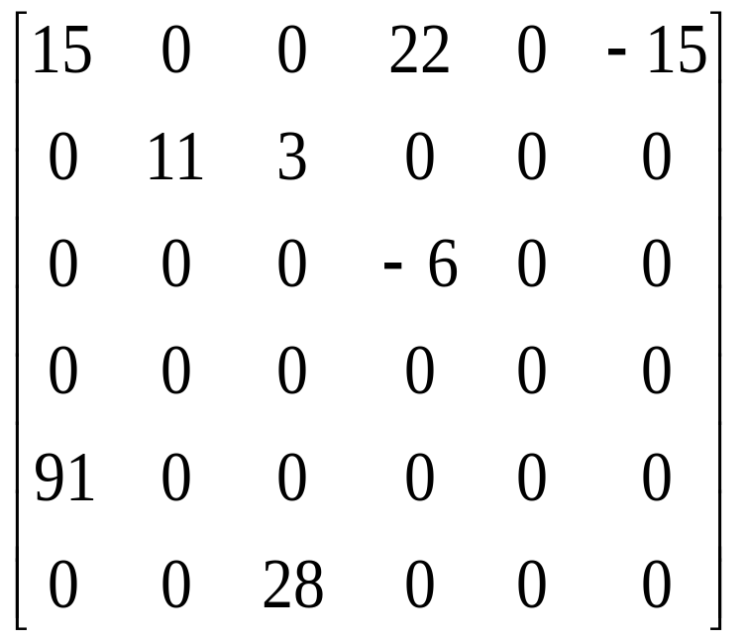
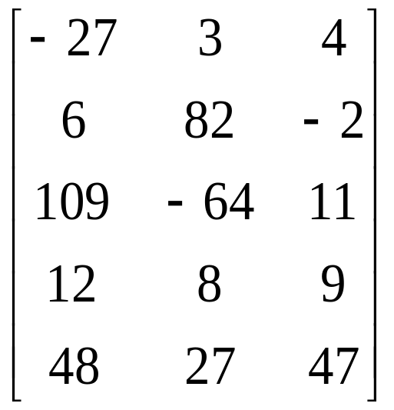
Sparse Matrices

Slide 3
ADT 2.3 Abstract data type SparseMatrix
class SparseMatrix
// objects: A set of triples, <row, column, value>, where row and column are integers and form a unique combinations; value is also an integer.
public:
SparseMatrix(int MaxRow, int MaxCol);
// the constructor function creates a SparseMatrix that can hold up to
// MaxInterms = MaxRow x MaxCol and whose maximum row size is MaxRow
// and whose maximum column size is MaxCol
SparseMatrix Transpose();
// returns the SparseMatrix obtained by interchanging the row and column value
// of every triple in *this
SparseMatrix Add(SparseMatrix b);
// if the dimensions of a (*this) and b are the same, then the matrix produced by
// adding corresponding items, namely those with identical row and column
// values is returned
// else error.
SparseMatrix Multiply(SparseMatrix b);
// if number of columns in a (*this) equals number of rows in b then the matrix d
// produced by multiplying a by b according to the formula d[i][j] =
// Σ(a[i][k] . b[k][j]), where d[i][j] is the (i, j)th element, is returned. k ranges from 0
// to the number of columns in a – 1
// else error
};

Slide 4
Sparse Matrix Representation
Use triple <row, column, value>
Store triples row by row
For all triples within a row, their column indices are in ascending order.
Must know the number of rows and columns and the number of nonzero elements

Slide 5
Sparse Matrix Representation (Cont.)
class SparseMatrix; // forward declaration
class MatrixTerm {
friend class SparseMatrix
private:
int row, col, value;
};
In class SparseMatrix:
private:
int Rows, Cols, Terms;
MatrixTerm smArray[MaxTerms];

Slide 6
Sparse Matrix Representation
(example)
row col value
smArray[0] 0 0 15
[1] 0 3 22
[2] 0 5 -15
[3] 1 1 11
[4] 1 2 3
[5] 2 3 -6
[6] 4 0 91
[7] 5 2 28
15 0 0 22 0 -15
0 11 3 0 0 0
0 0 0 -6 0 0
0 0 0 0 0 0
91 0 0 0 0 0
0 0 28 0 0 0

Slide 7
Transposing A Matrix
Intuitive way:
  for (each row i)
  take element (i, j, value) and store it in (j, i, value) of the transpose
More efficient way:
  for (all elements in column j)
  place element (i, j, value) in position (j, i, value)

Slide 8
Program 2.10 Transposing a Matrix
SparseMatrix SparseMatrix::Transpose()
// return the transpose of a (*this)
{
SparseMatrix b;
b.Rows = Cols; // rows in b = columns in a
b.Cols = Rows; // columns in b = rows in a
b.Terms = Terms; // terms in b = terms in a
if (Terms > 0) // nonzero matrix
{
int CurrentB = 0;
for (int c = 0; c < Cols; c++) // transpose by columns
for (int i = 0; i < Terms; i++)
// find elements in column c
if (smArray[i].col == c) {
b.smArray[CurrentB].row = c;
b.smArray[CurrentB].col = smArray[i].row;
b.smArray[CurrentB].value = smArray[i].value;
CurrentB++;
}
} // end of if (Terms > 0)
} // end of transpose
O(terms*columns)

Slide 9
Fast Matrix Transpose
The O(terms*columns) time => O(rows*columns²) when terms is the order of rows*columns
A better transpose function in Program 2.11. It first computes how many terms in each columns of matrix a before transposing to matrix b. Then it determines where is the starting point of each row for matrix b. Finally it moves each term from a to b.

Slide 10
Program 2.11 Fast Matrix Transposing
SparseMatrix SparseMatrix::Transpose()
// The transpose of a(*this) is placed in b and is found in Q(terms + columns) time.
{
int *Rows = new int[Cols];
int *RowStart = new int[Rows];
SparseMatrix b;
b.Rows = Cols; b.Cols = Rows; b.Terms = Terms;
if (Terms > 0) // nonzero matrix
{
// compute RowSize[i] = number of terms in row i of b
for (int i = 0; I < Cols; i++) RowSize[i] = 0; // Initialize
for ( I = 0; I < Terms; I++) RowSize[smArray[i].col]++;
// RowStart[i] = starting position of row i in b
RowStart[0] = 0;
for (i = 0; i < Cols; i++) RowStart[i] = RowStart[i-1] + RowSize[i-1];
O(columns)
O(terms)
O(columns-1)

Slide 11
Program 2.11 Fast Matrix Transposing (Cont.)
for (i = 1; I < Terms; i++) // move from a to b
{
int j = RowStart[smArray[i].col];
b.smArray[j].row = smArray[i].col;
b.smArray[j].col = smArray[i].row;
b.smArray[j].value = smArray[i].value;
RowStart[smArray[i].col]++;
} // end of for
} // end of if
delete [] RowSize;
delete [] RowStart;
return b;
} // end of FastTranspose
O(terms)
O(row * column)

Slide 12
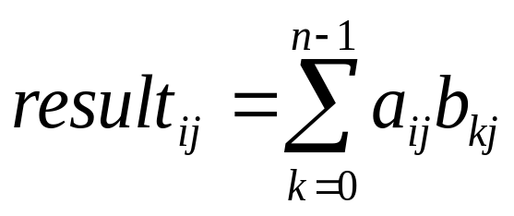
Matrix Multiplication
Definition: Given A and B, where A is mxn and B is nxp, the product matrix Result has dimension mxp. Its [i][j] element is
for 0 ≤ i < m and 0 ≤ j < p.

Slide 13
Sparse Matrix Multiplication
int SparseMatrix::StoreSum(int sun, int& LastInResult, int r, int c)
{
if(sum!=0){
if(LastInResult < MaxTerms-1){
LastInResult++ ;
smArray[LastInResult].row = r ;
smArray[LastInResult].col = c ;
smArray[LastInResult].value = sum ;
return 0 ;
}
else{
cerr << "Number of terms in product exceeds MaxTerms" << endl ;
retuen 1 ; // terminate program
}
}
else return 0 ;
} //end of StornSum

Slide 14
Sparse Matrix Multiplication
SparseMatrix SparseMatrix::Multiply(SparseMatrix b)
{
if(Cols!=b.Rows){
cout<< "Incompatible matrices" << endl ;
return EmptyMatrix();
}
if((Terms==MaxTerms)||(b.Terms==MaxTerms)){
cout<< "one additional space in a or b needed" << endl ;
return EmptyMatrix();
}
SparseMatrix bXpose = b.FastTranspose();
SparseMatrix result;
int currRowIndex = 0, LastInResult = -1,
currRowBegin = 0, currRowA = smArray[0].row ;
// set boundary conditions
smArray[Terms].row = Rows ; bXpose.smArray[b.Terms].row = b.Cols ;
bXpose.smArray[b.Terms].col = -1 ; int sum = 0 ;

Slide 15
Sparse Matrix Multiplication
while(currRowIndex < Terms) // generate row currRowA of result
{
int currColB = bXpose.smArray[0]; int currColIndex = 0 ;
while(currColIndex <= b.Terms)
{
// multiply row currRowA of a by column currColB of b
if(smArray[currRowIndex].row != currRowA) // end of row currRowA
{
if(result.StoreSun(sun, LastInResult, currRowA, currColB))
return EmptyMatrix(); // error
else sum=0 ; // reset sum
currRowIndex = currRowBegin ;
// go to next column
while(bXpose.smArray[currColIndex] == currColB)
currColIndex++ ;
currColB = bXpose.smArray[currColIndex].row ;
}

Slide 16
Sparse Matrix Multiplication
else if(bXpose.smArray[currColIndex].row != currColB){
// end of column currColB of b
if(result.StoreSun(sun, LastInResult, currRowA, currColB))
return EmptyMatrix(); // error
else sum=0 ; // reset sum
// set to multiply row currRowA with next column
currRowIndex = currRowBegin;
currColB = bXpose.smArray[currColIndex].row ;
}
else
switch( compare( smArray[currRowIndex].col,
bXpose.smArray[currColIndex].col )) {
case '<': // advance to next term in row
currRowIndex++; break ;
case '=': // add to sum
sum += smArray[currRowIndex].value*
bXpose.smArray[currColIndex].value ;
currRowInsex++; currColIndex++ ; break ;
case '>': // advance to next term in column currColB
currColIndex++;
} // end of switch
} // end of while(currColIndex <= b.Terms)

Slide 17
Sparse Matrix Multiplication
while(smArray[currRowIndex].row == currRowA) // advance to next row
currRowIndex++;
currRowBegin = currRowIndex ; currRowA = smArray[currRowIndex].row;
} // end of while(currRowIndex < Terms)
result.Row = Rows ; result.Cols = b.Cols ; result.Terms = LastInResult+1 ;
return result;
} // end of Multiply
O( B.Cols*A.Terms + A.Rows*B.Terms )

Slide 18
Representation of Arrays
Multidimensional arrays are usually implemented by one dimensional array via either row major order or column major order.
Example: One dimensional array
α
α+1
α+2
α+3
α+4
α+5
α+6
α+7
α+8
α+9
α+10
α+12
A[0]
A[1]
A[2]
A[3]
A[4]
A[5]
A[6]
A[7]
A[8]
A[9]
A[10]
A[11]

Slide 19
Two Dimensional Array Row Major Order
Col 0
Col 1
Col 2
Col u₂ - 1
Row 0
X
X
X
X
Row 1
X
X
X
X
Row u₁ - 1
X
X
X
X
u₂
elements
u₂
elements
Row 0
Row 1
Row i
Row u₁ - 1
i * u₂ element

Slide 20
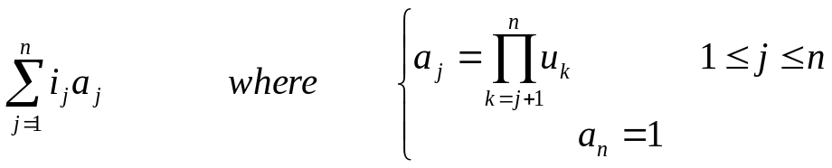
Generalizing Array Representation
The address indexing of Array A[i₁][i₂],…,[i_{n}] is
α+ i₁ u₂ u₃ … u_{n}
+ i₂ u₃ u₄ … u_{n}
+ i₃ u₄ u₅ … u_{n}
:
:
+ i_{n-1} u_{n}
+ i_{n}
=α+

